Slide 1

ADVANCED TRASHBOT
AI-Based Autonomous Smart Waste Collection Robot
Presented by:
Abdul Jobayer
Senarul Islam
Md Naimur Rahman Naiem
Prosenjit Mondal
MD Sakib Hasan
SMART CITY
AI
IOT
AUTONOMOUS ROBOTICS

Slide 2

The Unseen Challenge: Our Problem Statement
Waste management in urban and public spaces faces significant hurdles, impacting public health and environmental quality.
1
Overflowing Bins
Uncollected waste leads to unsightly scenes and unsanitary conditions.
2
Manual Collection Risks
Human involvement in waste collection often poses health and safety risks.
3
Poor Monitoring
Lack of real-time oversight in public areas exacerbates the problem.
4
Lack of Automation
Inefficient, traditional methods fail to keep pace with growing urban waste.

Slide 3

Driving Change: Motivation & Objectives
Our motivation stems from the critical need for a paradigm shift in waste management, aiming for cleaner, safer, and more efficient urban environments.
Why Automation is Needed
To mitigate health hazards for sanitation workers.
To enhance urban aesthetics and public hygiene.
To achieve sustainability goals for smart cities.
To reduce operational costs and increase efficiency.
Goal of TRASHBOT
To develop a smart, safe, and autonomous system for waste detection .
To provide real-time monitoring and alerts for optimal waste management.

Slide 4
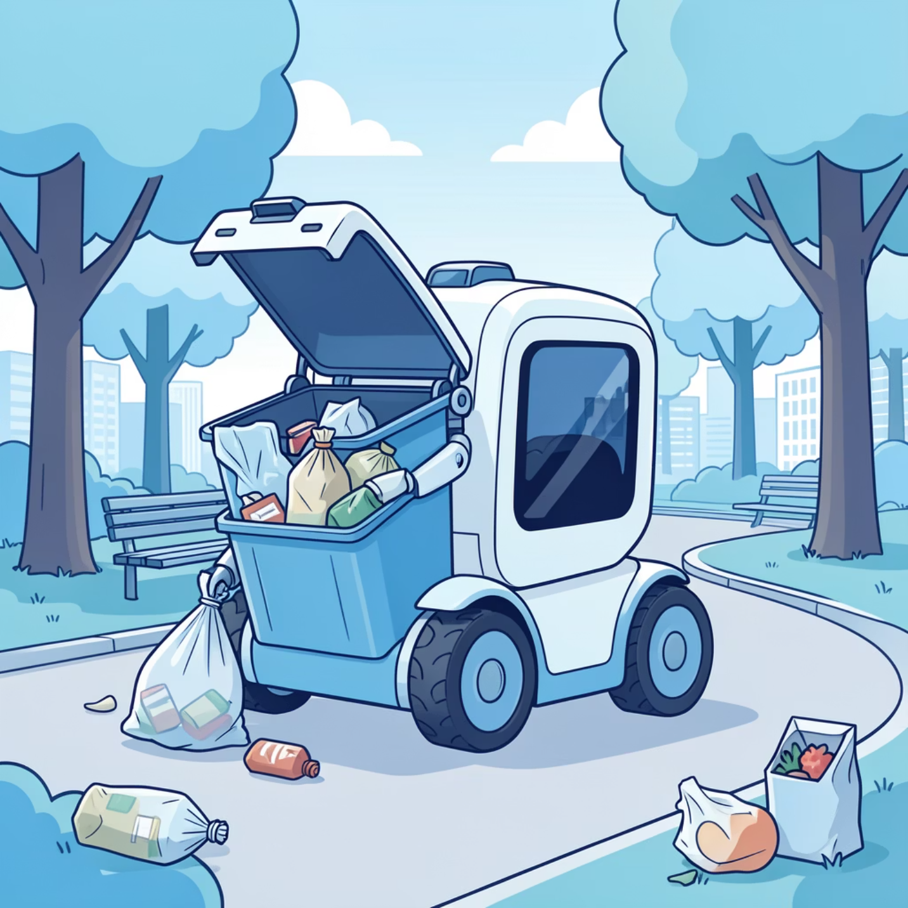
Introducing TRASHBOT: Our Autonomous Solution
The Advanced TRASHBOT is an AI-powered autonomous robot designed to revolutionize waste collection in public spaces.
Overview of the Robot
A self-navigating unit equipped with advanced sensors.
Capable of detecting and collecting various types of waste.
Integrates AI for intelligent decision-making.
Autonomous Trash Detection & Collection
Utilizes machine learning for precise object recognition.
A robotic arm securely grips and deposits waste.
Smart Alerts and Monitoring
Provides real-time updates on waste levels and robot status.
Generates alerts for anomalies or full bins.

Slide 5

System Architecture: The Brains Behind TRASHBOT
Our robust system architecture ensures seamless autonomous operation and effective waste management.
Vibration Sensor
Camera Sensor
Collision and motion alerts
Visual environmental data
Rain Sensor
TRASHBOT System Architecture
Ultrasonic Sensor
Precipitation detection
Distance and obstacle detection
Fire Sensor
Gas Sensor
Flame and heat detection
Air quality monitoring
Sensors: The eyes and ears of the TRASHBOT, gathering crucial environmental data.
Raspberry Pi: The central processing unit, running AI algorithms and controlling operations.
Robotic Arm: Precision mechanical component for waste collection.
IoT Module: Enables connectivity and data sharing with smart city infrastructure.
GSM SMS System: Critical for reliable alerts, especially in areas with no internet.

Slide 6





Core Capabilities: Key Features of TRASHBOT
TRASHBOT is engineered with a suite of advanced features for intelligent and safe waste collection.
Dual Operating Mode
Autonomous Navigation
Robotic Arm Pickup
Seamless switching between autonomous and remote-controlled operation.
Self-guided movement using GPS and obstacle avoidance systems.
Precise manipulation for effective trash collection and segregation.
Smart Bin Monitoring
Safety Sensors
Real-time level detection to prevent overflows and optimize routes.
Integrated sensors ensure safe operation around people and animals.

Slide 7

Sensor & Hardware Overview
TRASHBOT is equipped with a comprehensive array of sensors and hardware components for intelligent operation.
Camera: Visual data for AI trash detection and environment mapping.
Vibration Sensor: Detects unusual movements or impacts.
Ultrasonic Sensors: Accurate distance measurement for obstacle avoidance.
GPS Module: Precise localization and navigation capabilities.
Gas Sensor: Detects harmful gases, ensuring environmental safety.
GSM Module: Facilitates SMS communication without internet dependency.
Fire Sensor: Identifies potential fire hazards in waste bins.
Solar Panel: Provides sustainable power, extending operational time.
Rain Sensor: Enables adaptive behaviour during adverse weather conditions.

Slide 8





Robotic Arm & Waste Segregation
The TRASHBOT's robotic arm is designed for versatile trash collection and initial segregation, enhancing recycling efforts.
Servo-Based Robotic Hand
Multi-articulated for flexible reach and grip.
Equipped with pressure sensors for gentle yet firm handling.
Metal & Non-Metal Segregation
Integrated sensors classify waste materials in real-time.
Separate compartments within the robot for initial sorting.
Automatic Trash Pickup Workflow
Detect
Approach
AI identifies waste using camera input.
Robot navigates safely to the waste.
Grasp
Segregate
Robotic arm securely picks up the item.
Waste is classified and deposited into correct bins.

Slide 9

AI & Autonomous Operation: Intelligent Mobility
TRASHBOT leverages cutting-edge AI for intelligent decision-making, ensuring safe and efficient autonomous operation.
Camera + ML Trash Detection
Advanced machine learning models accurately identify various waste types.
Continuously learns and adapts to new debris and environments.
Obstacle Avoidance
Utilizes ultrasonic sensors and LiDAR for dynamic obstacle detection.
Intelligent path adjustments to navigate around people, vehicles, and objects.
Path Planning
Optimized routing algorithms for efficient coverage of designated areas.
Dynamic recalculation to avoid obstacles and adapt to changing conditions.
Crowd & Animal Safety
Integrated safety protocols to detect and maintain distance from living beings.
Voice alerts and flashing lights provide warnings to ensure public safety.

Slide 10




Real-Life Applications: Transforming Public Spaces
TRASHBOT's versatility makes it an invaluable asset across a wide range of public and private environments, contributing to cleaner communities.
Smart Cities
Parks & Streets
Railway & Bus Stations
Campuses & Malls
Integral to intelligent urban infrastructure, enhancing livability.
Maintaining pristine public spaces for recreation and daily life.
Ensuring cleanliness in high-traffic transport hubs.
Providing a pleasant and hygienic environment for students and shoppers.

Slide 11

Thank You

